Slide 1
Machine Learning Algorithms (IV)
Master´s in Applied Artificial Intelligence
Luís Ferreira
lufer@ipca.pt

Slide 2
Overview
Part I
Artificial Intelligence and Machine Learning
Foundations
Part II
Machine Learning
Part III
Machine Learning Algorithms
Parte IV
Deep Learning & Neural Networks
Parte V
Building a ML Model

Slide 3
Part III
Machine Learning Algorithms
Competencies to be acquired:
Deal with ML Algorithms
Ensemble Learning
Ensemble Models

Slide 4
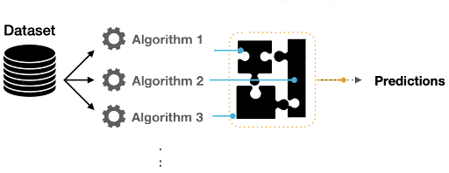
Part III: MLA
ML Ensemble
“…are a machine learning approach to combine multiple models in the prediction process…”

Slide 5
Part III: MLA
ML Ensemble
Why not only one model?
High variance: high sensitivity to the values of the learned features.
Low accuracy: One model to fit the entire training data might not provide sufficient results.
Features noise and bias: The model relies heavily on too few features while making a prediction.
Notes:
https://builtin.com/machine-learning/ensemble-model

Slide 6
Part III: MLA
ML Ensemble
Why ensemble?
The combination of multiple models by aggregating the output from each model has two objectives:
Reducing the model error
Maintaining the model’s generalization
Notes:
https://builtin.com/machine-learning/ensemble-model

Slide 7
Part III: MLA
ML Ensemble
Ensemble Techniques
  Bagging
  Boosting
  Stacking
  Blending
Notes:
https://builtin.com/machine-learning/ensemble-model

Slide 8
Part III: MLA
ML Ensemble
Bagging ( or Bootstrap Aggregation)
  Each model learns using a slightly different subset of the training data set (bootstraps)
  Training homogeneous “weak learners” on different random samples from the training set, in parallel.
Notes:
https://builtin.com/machine-learning/ensemble-model

Slide 9
Part III: MLA
ML Ensemble
Bagging
  Results are then combined through voting or averaging approach
  Bagging reduces variance and minimizes overfitting.
  Example: Random Forest Algorithm
  Bootstrap dataset: means samples can be reused!
  Out-Of-Bag dataset: not considered samples
Classsification
Regression
Notes:
https://builtin.com/machine-learning/ensemble-model

Slide 10
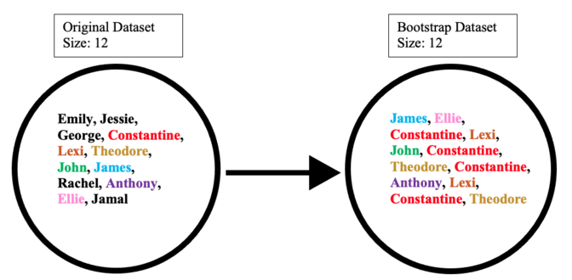
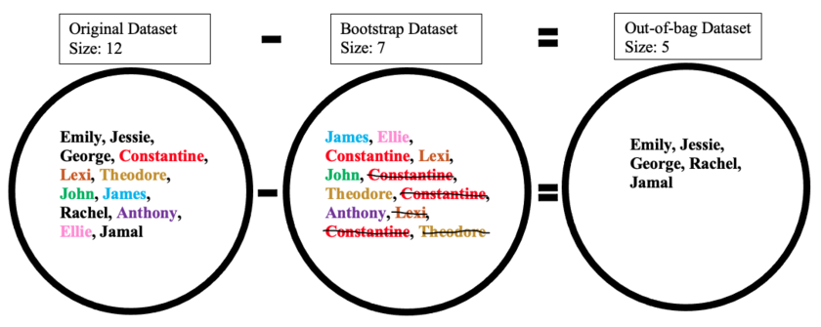
Part III: MLA
ML Ensemble
https://en.wikipedia.org/wiki/Bootstrap_aggregating
Bagging
  Results are then combined through voting or averaging approach
  Bagging reduces variance and minimizes overfitting.
  Example: Random Forest Algorithm
  Bootstrap Aggregation: means samples can be reused
Classsification
Regression
Notes:
https://builtin.com/machine-learning/ensemble-model

Slide 11
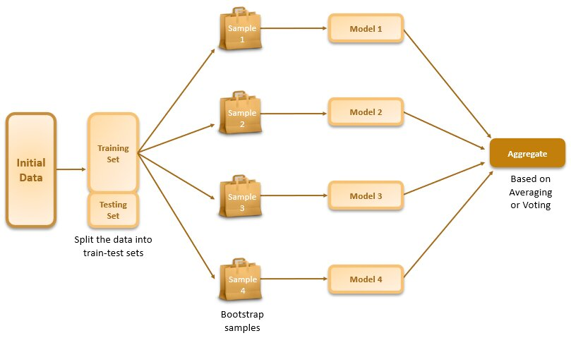
Part III: MLA
ML Ensemble
Bagging
  Results are then combined through voting or averaging approach
  Bagging reduces variance and minimizes overfitting.
  Example: Random Forest Algorithm
Notes:
https://builtin.com/machine-learning/ensemble-model
https://www.shiksha.com/online-courses/articles/ensemble-learning-bagging/

Slide 12
Part III: MLA
ML Ensemble
Boosting
  Method that involves training homogeneous “weak learners” sequentially such that a base model depends on the previously fitted base models!
  Each model is fitted iteratively in a manner that gives more weight or is only trained with observations that have been poorly classified (or misclassified) by the previous learners.
Notes:
https://builtin.com/machine-learning/ensemble-model
Boosting: https://www.shiksha.com/online-courses/articles/ensemble-learning-boosting/#s1

Slide 13

Part III: MLA
ML Ensemble
Boosting
  The ensemble model is the weighted sum of all constituent base learners.
  Helps reducing bias and avoiding underfitting
    Adaptive Boosting (AdaBoost)
    Gradient Boosting
Notes:
https://builtin.com/machine-learning/ensemble-model
Boosting: https://www.shiksha.com/online-courses/articles/ensemble-learning-boosting/#s1

Slide 14
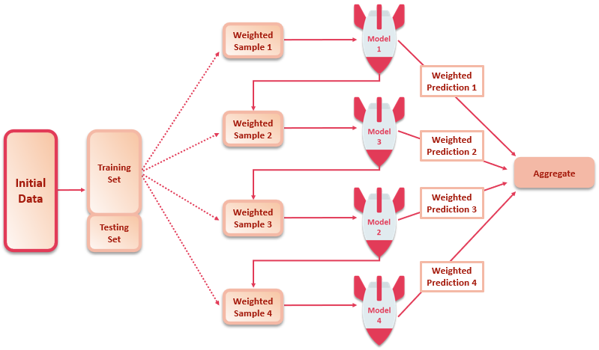
Part III: MLA
ML Ensemble
Boosting
  The ensemble model is the weighted sum of all constituent base learners.
  Helps reducing bias and avoiding underfitting
    Adaptive Boosting (AdaBoost)
    Gradient Boosting
a) the greater the error, the weight of the sample increases
b) does well on its predictions, gets a higher weight assigned to it
Notes:
https://builtin.com/machine-learning/ensemble-model
Boosting: https://www.shiksha.com/online-courses/articles/ensemble-learning-boosting/#s1

Slide 15
Part III: MLA
ML Ensemble
Remember:
Bias error comes up when an algorithm makes incorrect assumptions about the relationship between the features and target variable in the training data. High bias causes the underfitting of the model.
Variance error is caused by over-sensitivity to minimal fluctuations in the training data. Due to this, the model learns noise from the data. A high variance would result in the overfitting of the model.
Notes:
https://www.shiksha.com/online-courses/articles/ensemble-learning-bagging/

Slide 16
Part III: MLA
ML Ensemble
When to use?
  Boosting:
    - When the base model has low variance but high bias and high noise ➔ reduce underfiting!
  Bagging:
    When data has high variance, low bias, and low noise
    ➔ reduce overfiting
Notes:
https://builtin.com/machine-learning/ensemble-model
Boosting: https://www.shiksha.com/online-courses/articles/ensemble-learning-boosting/#s1

Slide 17
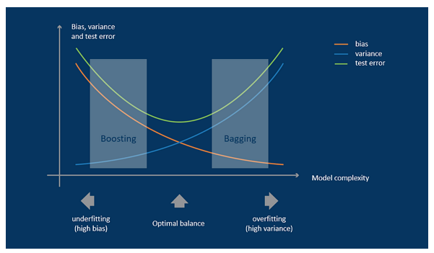
Part III: MLA
ML Ensemble
When to use?
  Boosting:
    - When the base model has low variance but high bias and high noise ➔ reduce underfiting!
  Bagging:
    When data has high variance, low bias, and low noise
    ➔ reduce overfiting
Notes:
https://builtin.com/machine-learning/ensemble-model
https://www.aiacceleratorinstitute.com/boosting-and-bagging-powerful-ensemble-methods-in-machine-learning/

Slide 18
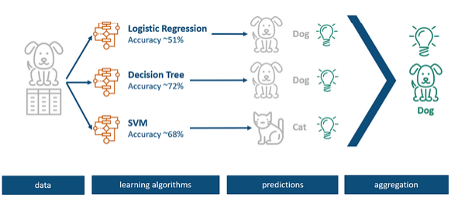
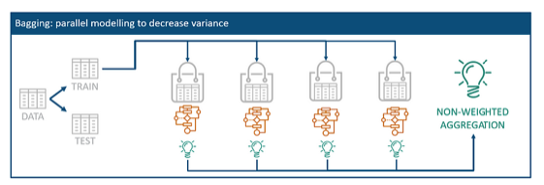
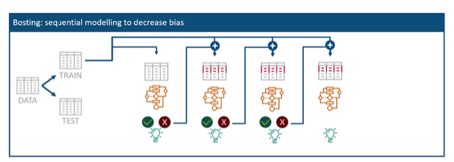
Part III: MLA
ML Ensemble
When to use?
  Boosting:
    - When the base model has low variance but high bias and high noise ➔ reduce underfiting!
  Bagging:
    When data has high variance, low bias, and low noise
    ➔ reduce overfiting
Notes:
https://builtin.com/machine-learning/ensemble-model
https://www.aiacceleratorinstitute.com/boosting-and-bagging-powerful-ensemble-methods-in-machine-learning/

Slide 19
Part III: MLA
ML Ensemble
Example of an Ensemble Model :
  Classification problem
  Models: k-Nearest Neighbors (K-NN), Random Forest, Logistic Regression
  Instances of each model: set hyperparameters for Cross-validation
  Voting : sklearn VotingClassifier

Slide 20
Part III: MLA
ML Ensemble
Example of an Ensemble Model :
  Jupyter 9 - Ensemble Models.ipynb

Slide 21
Part III: MLA
References
  Ensemble Models: What Are They and When Should You Use Them?
  https://builtin.com/machine-learning/ensemble-model
  Ensembles: Gradient boosting, random forests, bagging, voting, stacking
  https://scikit-learn.org/stable/modules/ensemble.html

Slide 22
Progress
Part I
Artificial Intelligence and Machine Learning
Foundations
Part II
Machine Learning
Part III
Machine Learning Algorithms (I)
Part IV
Machine Learning Algorithms (II)
Part V
Deep Learning & Neural Networks

Slide 23
References
  Machine Learning for Everyone https://vas3k.com/blog/machine_learning/
  Building a Machine Learning Pipeline with Scikit-Learn
    https://towardsdatascience.com/building-a-machine-learning-pipeline-3bba20c2352b
  https://www.ibm.com/topics/machine-learning-pipeline
  https://neptune.ai/blog/best-open-source-mlops-tools

Slide 24
References
Machine Learning. Tom M. Mitchel, McGraw-Hill, 1997
Machine Learning for Everyone
  https://vas3k.com/blog/machine_learning/
Machine Learning Tutorial
  https://www.simplilearn.com/tutorials/machine-learning-tutorial/machine-learning-steps
What is machine learning and how does it work? In-depth guide
  https://www.techtarget.com/searchenterpriseai/definition/machine-learning-ML

Slide 25
Appendices

Slide 26
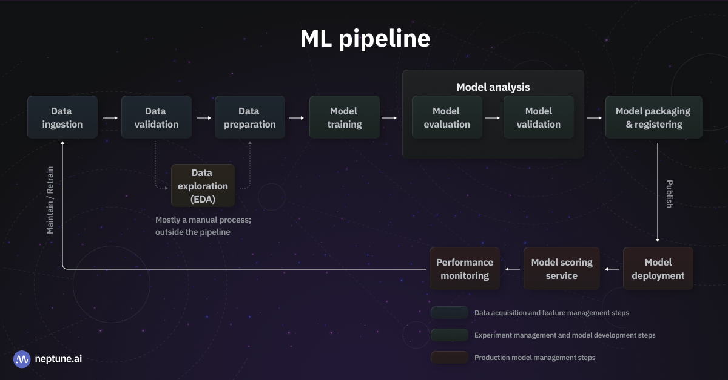
Appendices

